Slide 1
Cheaters claim they knew the answers all along
Alexandria R. Stone, B.S., B.A
Matthew L. Stanley, M.A
Elizabeth Marsh, Ph.D
Duke University
OSF
Manuscript in press at Psychonomic Bulletin & Review
alexandria.stone@duke.edu
#3037 - Stone

Slide 2
Introduction
#3037 - Stone
Cheating is extremely prevalent & is unlikely to be caught ^{1, 2}
People are strongly motivated to enhance and protect their favorable self-concept ^{3, 4, 5}
QUESTION: Why is it that people can cheat without damaging their favorable self-concept?
H1: Cheating is associated with amplified estimates of prior knowledge
H2: Cheaters, relative to those who do not cheat, will be more likely to believe the knew the correct answers all along
1) McCabe, Trevino, & Butterfield, 2001; 2) McCabe & Trevino, 1997; 3) Stanley & DeBrigard, 2019; 4) Stanley, Henne, & DeBrigard 2019; 5) Aquino & Reed, 2002
Notes:
There is no denying that cheating is extremely prevalent in our society
For example, considering the infamous 2012 Harvard cheating scandal in which 125 students were investigated for cheating
**** This high-profile case is unique in that cheating was caught →
Not that surprisingly, majority of cheating cases go unnoticed
**** Despite the pervasiveness of cheating, people like to view themselves as favorable → that is, one who exemplifies positive traits like honesty, integrity, and trustworthiness.
**** The pervasiveness of cheating is in direct contrast with people’s beliefs that they are honest and trustworthy → so why is it that people can cheat without damaging their favorable self-concept?
The knew it all along effect offers one way people can rationalize their cheating behaviors --> that is, cheating may be deemed okay or even justified if they believe they knew the answer all along
You could imagine, for example, if you glance over at your neighbors test and notice their answer --> one may convince themselves they already knew the answer and therefore did not cheat in that moment
In 3 studies, we tested two main hypotheses:
**** Fist, that cheating is associated with overconfident estimates of prior knowledge
**** And secondly that cheaters, relative to those who do not cheat, would report a greater knew-it-al-along effect

Slide 3
STUDY 1
#3037 - Stone
Participants cheated on roughly 14% of the questions
H1: Cheating is associated with amplified estimates of prior knowledge
People who most likely cheated were more likely to report that they knew the correct answer all along (N=147, b=3.20, SE=.10, t=31.53, p<.001, 95% CI = [2.99, 3.42]).
Notes:
In S1, subjects were asked to answer 24 trivia questions – 12 difficult and 12 easy questions.
****They were told that the correct answer to each question was located upside down on the screen in small font BUT were instructed that it would be cheating to peak at the answer.
****After a 2-min distractor task, **** participants were shown all 24 questions again with the correct answer and asked to indicate whether they knew the answer to each question prior to the beginning of the study using a Likert scale from 1 = this was new to me to 7= I actually knew this all along
Overall, ****participants correctly answered 14% of the difficult questions
We want to point out that these 12 difficult questions were normed, and that pretesting revealed that no one knew the correct answers to these questions→ meaning, the 14% answered correctly is reflective of cheating
****In regards to our first hypothesis, results revealed that ***for questions in which participants provided the correct answer, participants were more likely to report that they knew the answer all along, relative to questions for which participants did not provide the correct answer

Slide 4
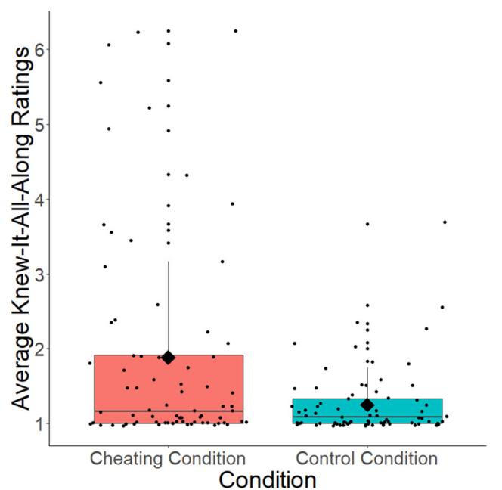
STUDY 2
#3037 - Stone
CONTROL Condition
H2: Cheaters, relative to those who do not cheat, will be more likely to believe the knew the correct answers all along
People who most likely cheated were more likely to report that they knew the correct answer all along (N=150, b=2.96, SE=.15, t=19.83, p<.001, 95% CI = [2.66, 3.25]).
People with the opportunity to cheat reported higher knew-it-all-along judgements (N=150, b=.63, SE=.17, t=3.76, p<.001, 95% CI = [.33, 95]).
Notes:
S2 was an experimental, between –subjects, study design in which participants were randomly assigned to one of two conditions – the cheating condition or the control condition
Subjects in the Cheating condition underwent the exact same procedure as S1 – they answered each questions with the opportunity to cheat.
In contrast, subjects in the ****control condition had no opportunity to cheat
They first attempted to answer each question, and then, after submitting their response, ****were shown the correct answer to the question on the following page
****S2 replicated findings of S1 that for questions in which participants likely cheated, they were more likely to report that they knew the correct answer all along
****S2 results confirmed our H2 that ****participants who had the opportunity to cheat, relative to those who did not, reported higher knew it all along judgments

Slide 5
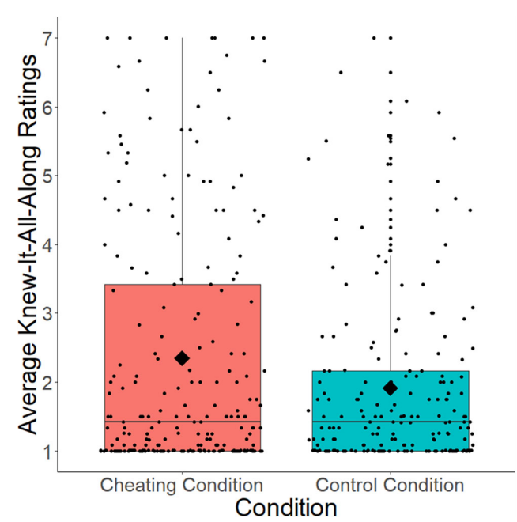
Study 3
#3037 - Stone
CONTROL & CHEATING Condition
People who most likely cheated were more likely to report that they knew the correct answer all along (N=412, b=2.13, SE=.09, t=24.01, p<.001, 95% CI = [1.96, 2.32]).
People with the opportunity to cheat reported higher knew-it-all-along judgements (N=412, b=.43, SE=.16, t=2.77, p<.006, 95% CI = [.13, .74]).
Notes:
S3 included a few procedural changes to account for alternative explanations that could explain the observed effects seen in S2
For starters, we explicitly included an instructional check to ensure that participants understood that their prior knowledge judgements would not have any negative repercussions
****We also streamlined the comparison by having both condition in S3 see exactly the same information at the same time – the only difference being whether looking at the answers was prohibited or allowed
**** As shown in S1 & S2 our H1 and H2 was confirmed
In sum, we found consistent correlational evidence across 3 studies that that for those particular cases in which participants likely cheated, they were more likely to report that the knew with answers all along.
To show that this was not just a simply knew it all along effect, we also found experimental evidence that participants were more likely to later claim they knew the answers all along after having the opportunity to cheat to find the answers, this was relative to exposure to the correct answers without the opportunity to cheat.
Our results are consistent with the idea that people are motivated to believe that they already knew the answers to the questions they cheated on, and that in a sense, cheating poses no threat to one’s favorable self-concept

